Slide 1

Organizational Behavior
(MGT-502)
Lecture-37

Slide 2
Summary of
Lecture-36

Slide 3

Organizational Culture

Slide 4
Organizational Culture?
A common perception held by the organization’s members; a system of shared meaning
  Shared things
  Shared sayings
  Shared doings
  Shared feelings

Slide 5
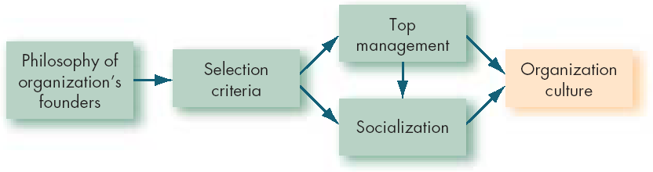
How Organization Cultures Form

Slide 6
Stories
Rituals
How Employees
Learn Culture
Language
Material
Symbols

Slide 7
Four Functions of Organizational Culture
Organizational
identity
Sense-making
device
Collective
commitment
Organizational
culture
Social system
stability

Slide 8
Today’s Topics

Slide 9
How to Change a Culture
If the culture no longer supports the goals and strategy of an organization, it should be changed.
Mergers and acquisitions generally result in a change in culture.

Slide 10
Requirements for Successfully Changing Organizational Culture
Understand the old culture first.
Support employees and teams who have ideas for a better culture and are willing to act on those ideas.
Find the most effective subculture in the organization and use it as a model.
Help employees and teams do their jobs more effectively.
Use the vision of a new culture as a guide for change.
Recognize that significant cultural change takes time.

Slide 11
Changing the Culture of an Organization
Define the
Elements of the
New Culture
Communicate the
New Culture to
Employees
Realign the
Organizational
Policies and
Practices to
Support the
New Culture
Evaluate the Culture
of the Firm in
Relation to the
Firm’s Mission
Replace Managers
and Employees
Who Do Not
Embrace the
New Culture
Use Formal
Mechanisms to
Reinforce and
Transmit the
New Culture

Slide 12
Guidelines for Managing Cultural Diversity
Organization members must:
  Recognize and value a variety of opinion and insight.
  Recognize the learning opportunities and challenges presented by the expression of different perspectives.
The organizational culture must:
  Foster high performance expectations for everyone.
  Stimulate personal development.
  Encourage openness.
  Make workers feel valued.
The organization must have:
  A well-articulated and widely understood mission.

Slide 13
Actions Organizations Can Take to Develop an Ethical Culture
Be realistic in setting values and goals regarding employee relationships.
Encourage input from organization members regarding appropriate values and practices for implementing the culture.
Do not automatically opt for a “strong” culture.
Provide training on adopting and implementing the organization’s values.

Slide 14
Effects of Organizational Culture on
Employee Behavior and Performance
Allows employees to understand the firm’s history and current approach.
Fosters commitment to corporate philosophy and values.
Serves as a control mechanism for employee behaviors.
Certain cultural types may produce greater effectiveness and productivity.

Slide 15
Culture’s Effects on Behavior
Communication
Cooperation
Commitment
Decision Making
Implementation

Slide 16
Why is Org Culture Important?
Behavioral guidelines
Establishes commitment/identity
Control mechanism
Greater effectiveness and productivity

Slide 17

Cultural Modifications in the Current Business Environment
Support for a global
view of business
Empowerment of
employees to excel
in product and
service quality
Reinforcement of
ethical behavior

Slide 18
So What????
Organizational culture matters!!
  Some firms are ethical
  Some firms value people
  Some firms like to work
  Some places value rules, status
  Employees behave differently

Slide 19
Organizational Change

Slide 20
What Is Change??
When we speak of change, we mean an alteration in organization design, strategy or processes, or some other attempt to influence an organization’s members to behave differently
Jay W. Lorsch

Slide 21

Species Must Change or They Will Die
Some have failed to change and have died

Slide 22
Some have changed and have thrived

Slide 23
Organizations, Too, Must Change or Die

Slide 24

Change or Disappear

Slide 25
External
What Are the
Forces for
Change?
Internal
Notes:
4

Slide 26
Forces For Change
External Forces
Economic Forces
Technology
Social and Political Change
Organizational
Change
Process
Behavioral
Internal Forces

Slide 27
Internal Forces for Change
Company
Crisis
Declining
Effectiveness
Changing
Employee
Expectations
Changing
Work Climate
Notes:
6

Slide 28

External Forces for Change
Workforce
Diversity
Globalization
Changing
Technology
Ethical
Behavior
Notes:
3

Slide 29


Organizational Change
Planned Change - change resulting from a deliberate decision to alter the organization
Unplanned Change - change that is imposed on the organization and is often unforeseen
Managers must be
prepared to handle both
Notes:
2

Slide 30


Types of Change
Planned
Unplanned
Evolutionary
Revolutionary
Notes:
6

Slide 31
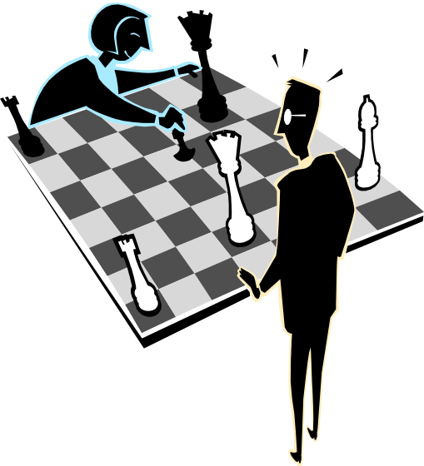
Strategic Change
Major transformations in the structure, size, or functioning of an organization for the purpose of achieving strategic objectives
Degree of Change:
  Radical change
    Major adjustments in the
    ways a firm does business
  Incremental change
    Evolution over time
    Many small routine changes

Slide 32
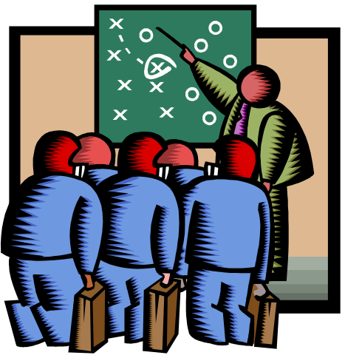
Timing of Change
Reactive Change:
  Responding to changes in the external or internal environment.
Anticipatory Change:
  Looking for better ways to stay
  ahead of the competition.
Notes:
R

Slide 33
Force Field
Driving Forces
Resistance Forces

Slide 34
Why People Resist Change
Direct Costs/Limited Resources
Saving Face/Vested Interests
Fear of the Unknown
Breaking Traditions/Routines
Incongruent Systems
Incongruent Team Dynamics

Slide 35
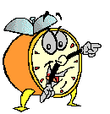
Let’s stop it here

Slide 36
Summary

Slide 37
Culture’s Effects on Behavior
Communication
Cooperation
Commitment
Decision Making
Implementation

Slide 38
Why is Org Culture Important?
Behavioral guidelines
Establishes commitment/identity
Control mechanism
Greater effectiveness and productivity

Slide 39
Organizational Change

Slide 40
Change or Disappear

Slide 41
Forces For Change
External Forces
Economic Forces
Technology
Social and Political Change
Organizational
Change
Process
Behavioral
Internal Forces

Slide 42
Next….

Slide 43
Organizational Behavior
(MGT-502)
Lecture-37

